Slide 1
Introduction to Statistical Methods
ISM TEAM

Slide 2
Course No: AIML CZC418
WEBINAR 2 : 08/09/2026

Slide 3
Agenda
Bayes’ Theorem
Naïve Bayes Classifier
Random Variables

Slide 4
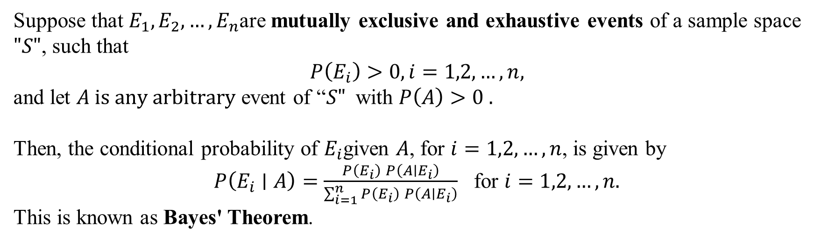
BAYES’ THEOREM:
Suppose that $E_{1},E_{2},…,E_{n}$are mutually exclusive and exhaustive events of a sample space $"S"$, such that
$$P\left(E_{i}\right)>0, i=1,2,…,n,$$
and let $A is any arbitrary$ event of “$S"$with $P\left(A\right)>0 .$
Then, the conditional probability of $E_{i}$given $A$, for $i=1,2,…,n$, is given by
$P\left(E_{i}∣A\right)=\frac{P\left(E_{i}\right) P\left(A∣E_{i}\right)}{\sum_{i=1}^{n}{P}\left(E_{i}\right) P\left(A∣E_{i}\right)}$ for $i=1,2,…,n.$
This is known as Bayes' Theorem.
Bayes’ theorem is also known as the formula for the probability of “causes”. As we know, the E_{i}‘s are a partition of the sample space S, and at any given time only one of the events E_{i} occurs. Thus, we conclude that the Bayes’ theorem formula gives the probability of a particular E_{i}, given the event A has occurred.

Slide 5
Terms related to Bayes Theorem
Hypotheses: Events happening in the sample space E₁, E₂,… E_{n} is called the hypotheses
Priori Probability: Priori Probability is the initial probability of an event occurring before any new data is taken into account. P(E_{i}) is the priori probability of hypothesis E_{i}.
Posterior Probability: Posterior Probability is the updated probability of an event after considering new information. Probability P(E_{i}|A) is considered as the posterior probability of hypothesis E_{i}.

Slide 6
Applications of Bayes Theorem
Bayesian inference is very important and has found application in various activities, including medicine, science, philosophy, engineering, sports, law, etc., and Bayesian inference is directly derived from Bayes’ theorem.
Example: Bayes’ theorem defines the accuracy of the medical test by taking into account how likely a person is to have a disease and what is the overall accuracy of the test.

Slide 7
Problem 1
A hospital has 4 nurses handling respectively 20%, 40%, 25% and 15% of the patients of all the doctors coming to the hospital. The probability that they misguide the patients are respectively 0.05, 0.03, 0.04 and 0.05. Find the probability that the misguided incident can be blamed on the third nurse.

Slide 8
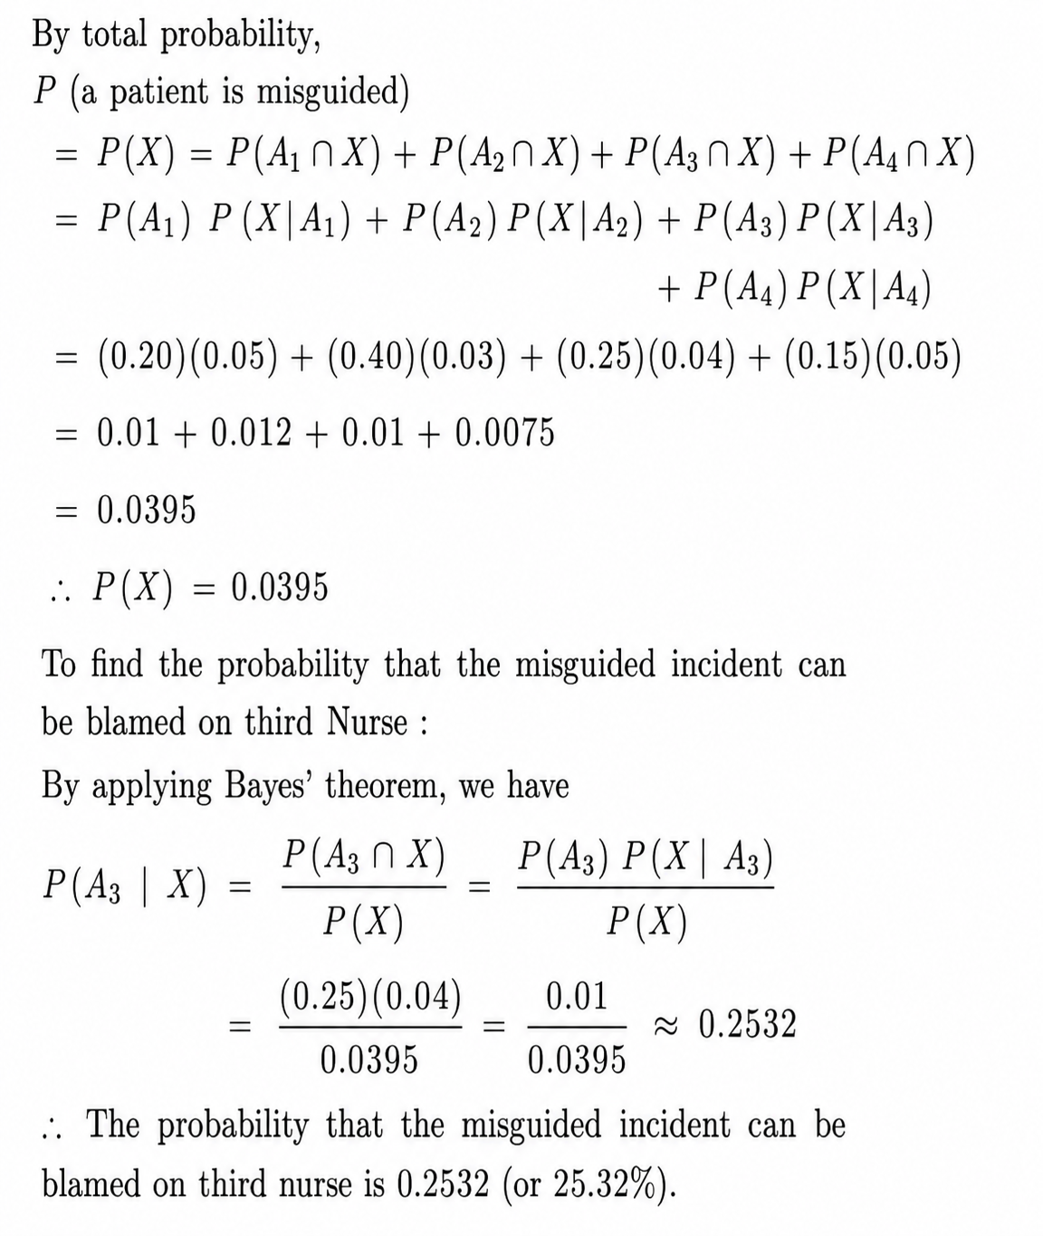
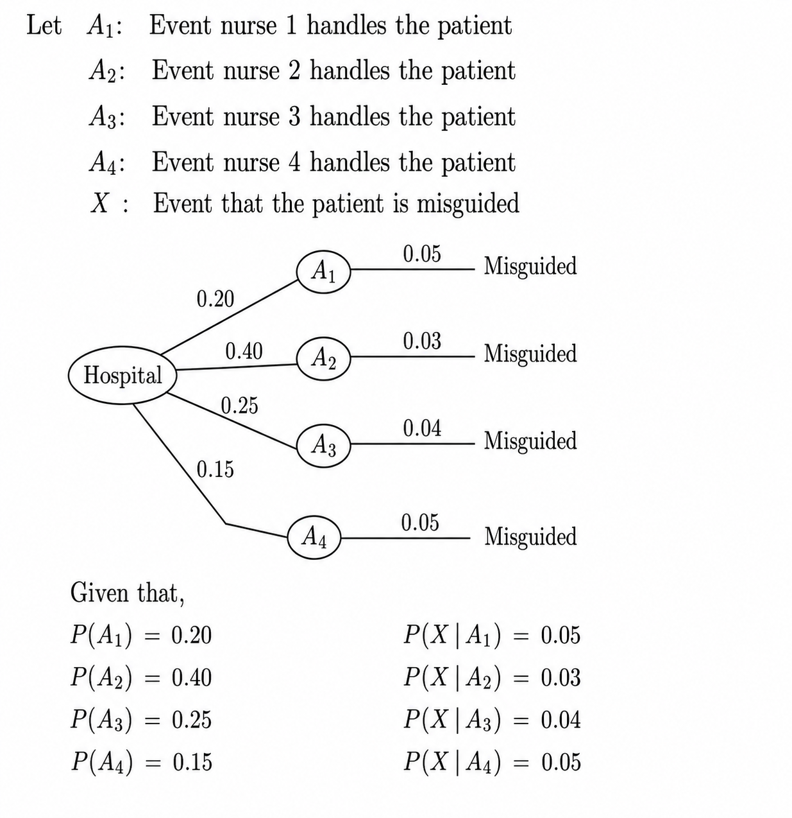
Problem 1 - Solution

Slide 9
Problem 2
Three machines A, B and C produce respectively 50%, 30% and 20% of the total number of items of a factory. The percentage of defective outputs of these machines are 3%, 5% and 2%. An item is selected at random and is found to be defective. (i) Find the probability that the item was produced by machine C? (ii) What is the probability that the item was produced by machine C or B?(iii) What is the probability that an item selected at random is found to be non-defective and also the probability that the item was produced by machine A given that it is non-defective.

Slide 10
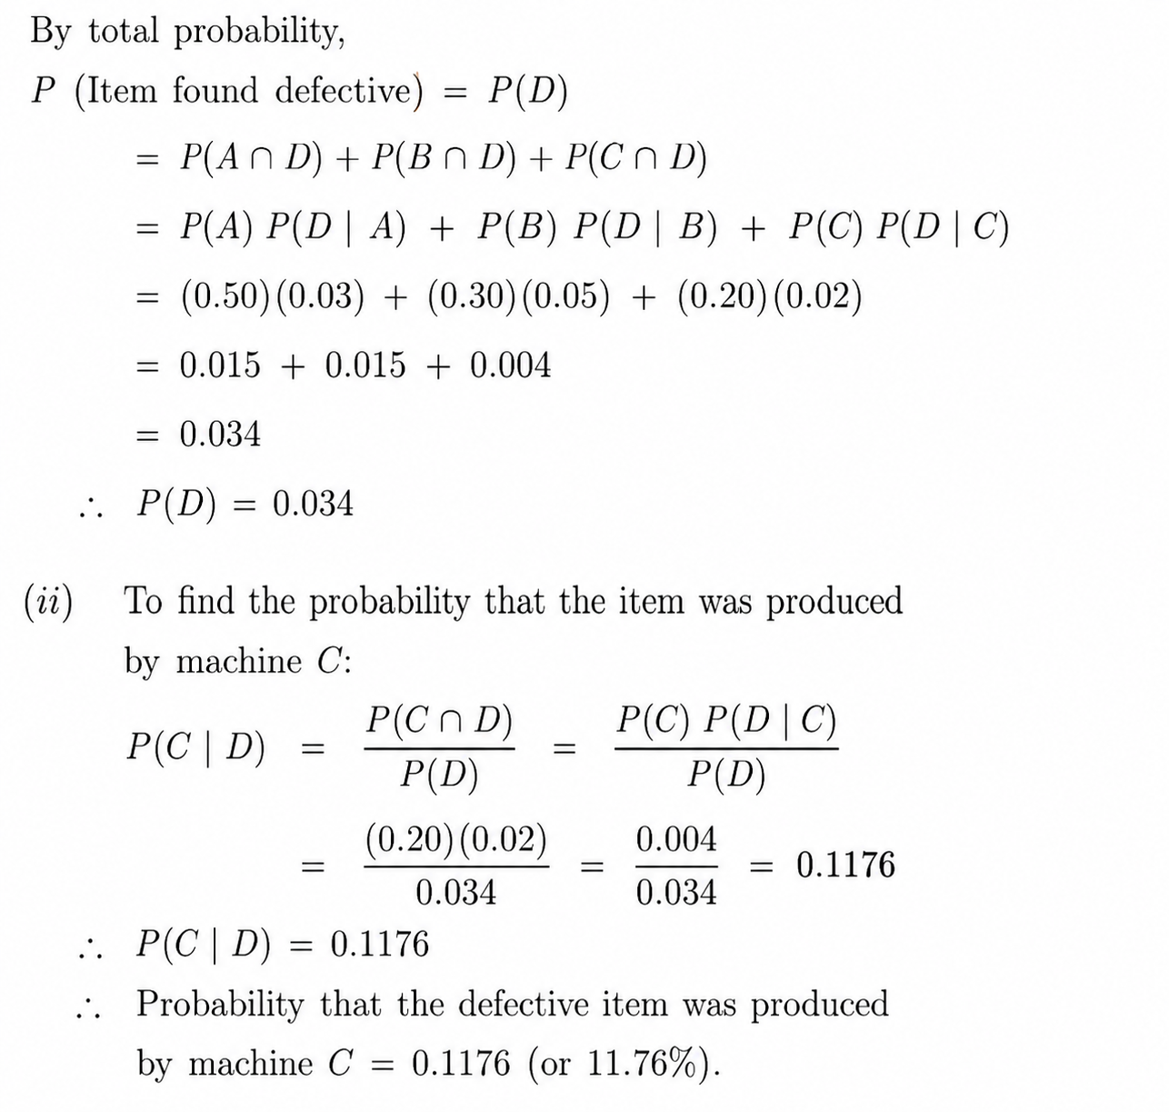
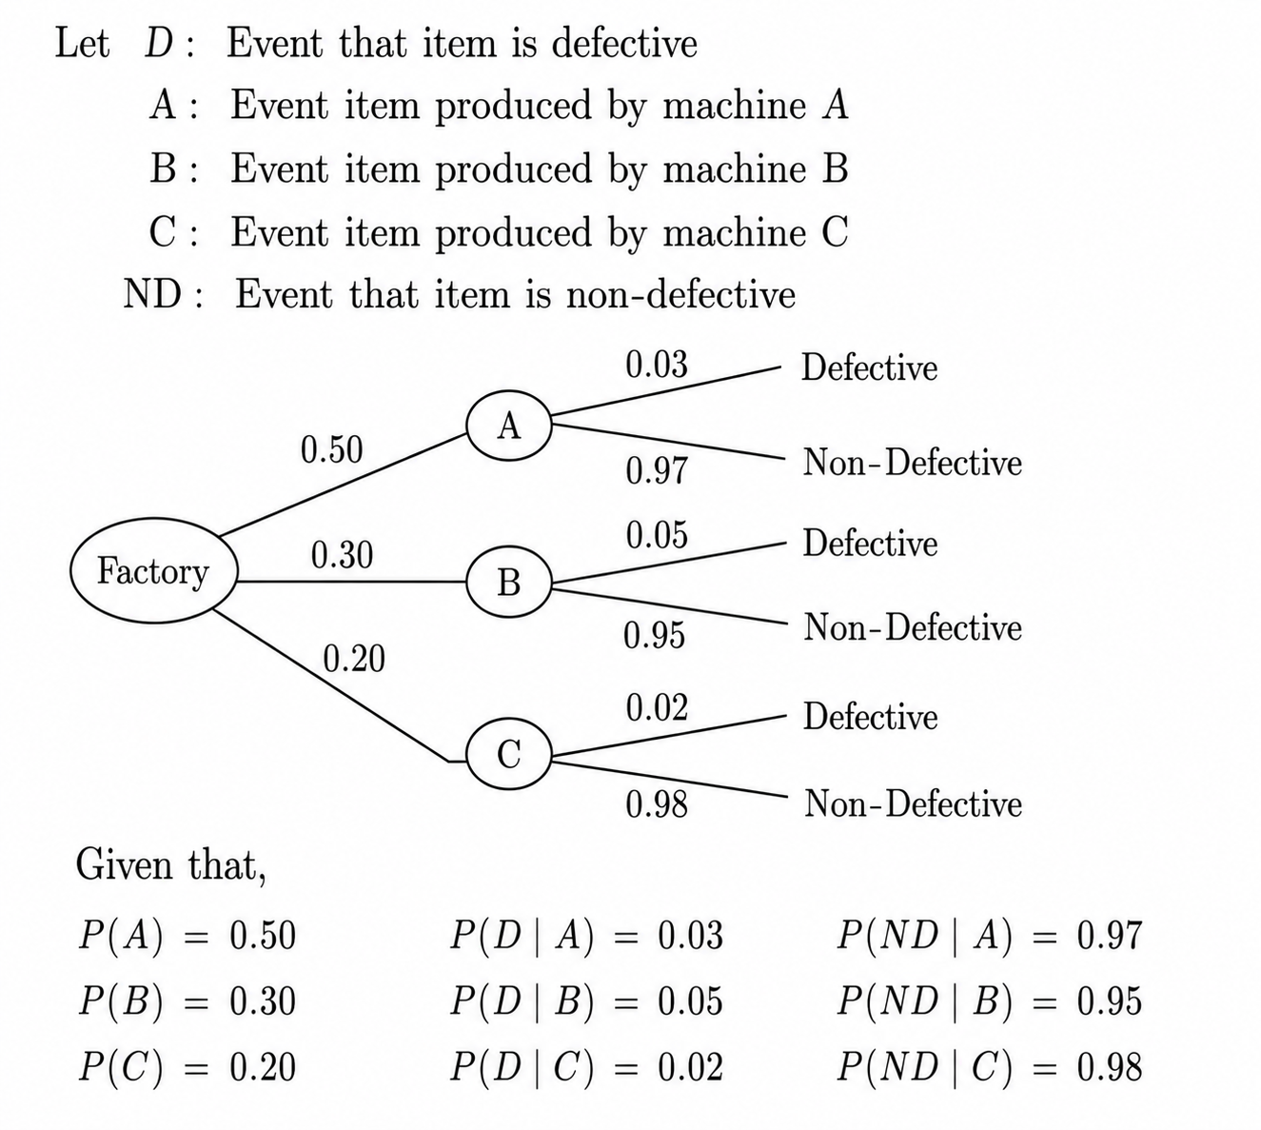
Problem 2 - Solution

Slide 11
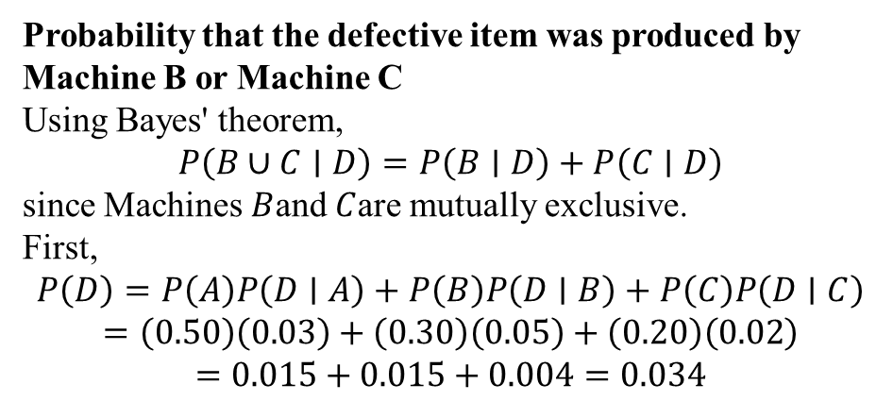
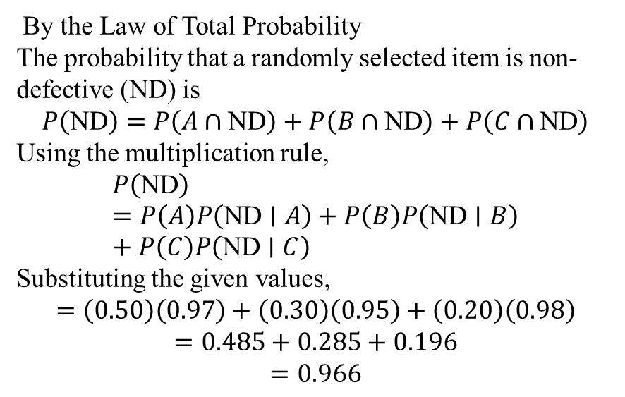
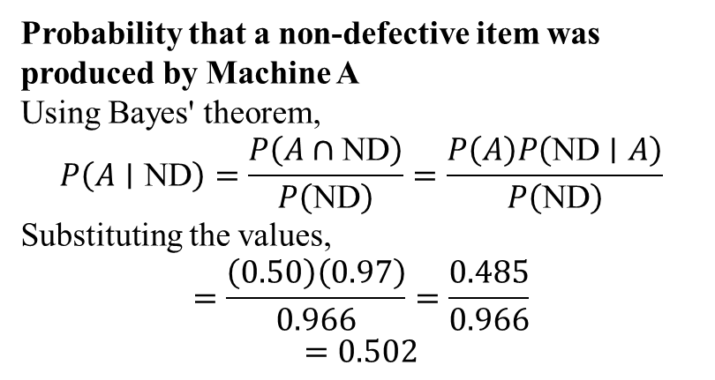
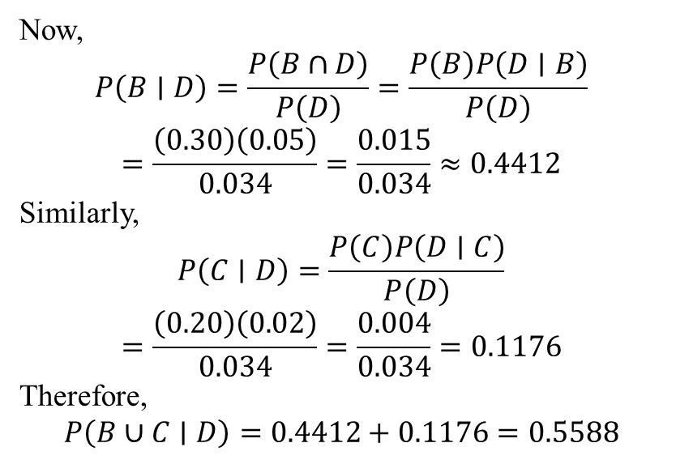
By the Law of Total Probability
The probability that a randomly selected item is non-defective (ND) is
$$P\left(\text{ND}\right)=P\left(A∩\text{ND}\right)+P\left(B∩\text{ND}\right)+P\left(C∩\text{ND}\right)$$
Using the multiplication rule,
$$P\left(\text{ND}\right)=P\left(A\right)P\left(\text{ND}∣A\right)+P\left(B\right)P\left(\text{ND}∣B\right)+P\left(C\right)P\left(\text{ND}∣C\right)$$
Substituting the given values,
$$=\left(0.50\right)\left(0.97\right)+\left(0.30\right)\left(0.95\right)+\left(0.20\right)\left(0.98\right)$$
$$=0.485+0.285+0.196$$
$$=0.966$$
Now,
$$P\left(B∣D\right)=\frac{P\left(B∩D\right)}{P\left(D\right)}=\frac{P\left(B\right)P\left(D∣B\right)}{P\left(D\right)}$$
$$=\frac{\left(0.30\right)\left(0.05\right)}{0.034}=\frac{0.015}{0.034}≈0.4412$$
Similarly,
$$P\left(C∣D\right)=\frac{P\left(C\right)P\left(D∣C\right)}{P\left(D\right)}$$
$$=\frac{\left(0.20\right)\left(0.02\right)}{0.034}=\frac{0.004}{0.034}=0.1176$$
Therefore,
$$P\left(B∪C∣D\right)=0.4412+0.1176=0.5588$$
Probability that the defective item was produced by Machine B or Machine C
Using Bayes' theorem,
$$P\left(B∪C∣D\right)=P\left(B∣D\right)+P\left(C∣D\right)$$
since Machines $B$and $C$are mutually exclusive.
First,
$$P\left(D\right)=P\left(A\right)P\left(D∣A\right)+P\left(B\right)P\left(D∣B\right)+P\left(C\right)P\left(D∣C\right)$$
$$=\left(0.50\right)\left(0.03\right)+\left(0.30\right)\left(0.05\right)+\left(0.20\right)\left(0.02\right)$$
$$=0.015+0.015+0.004=0.034$$
Probability that a non-defective item was produced by Machine A
Using Bayes' theorem,
$$P\left(A∣\text{ND}\right)=\frac{P\left(A∩\text{ND}\right)}{P\left(\text{ND}\right)}=\frac{P\left(A\right)P\left(\text{ND}∣A\right)}{P\left(\text{ND}\right)}$$
Substituting the values,
$$=\frac{\left(0.50\right)\left(0.97\right)}{0.966}=\frac{0.485}{0.966}$$
$$=0.502$$

Slide 12
Problem 3
EC2R
JULY 2024
Hardik Pandya, Rishabh Pant and Surya Kumar Yadav are in the race of leading Indian cricket team in the next world cup with probabilities 0.2, 0.5 and 0.3 respectively. The probabilities of getting an increase in the match fee by Hardik, Rishabh and Surya are 0.3, 0.6 and 0.5 respectively if they become the Captain.
If there is an increase in match fee then find the probability
that it is because of Hardik
that it is because of Rishabh
that it is because of Surya Kumar

Slide 13
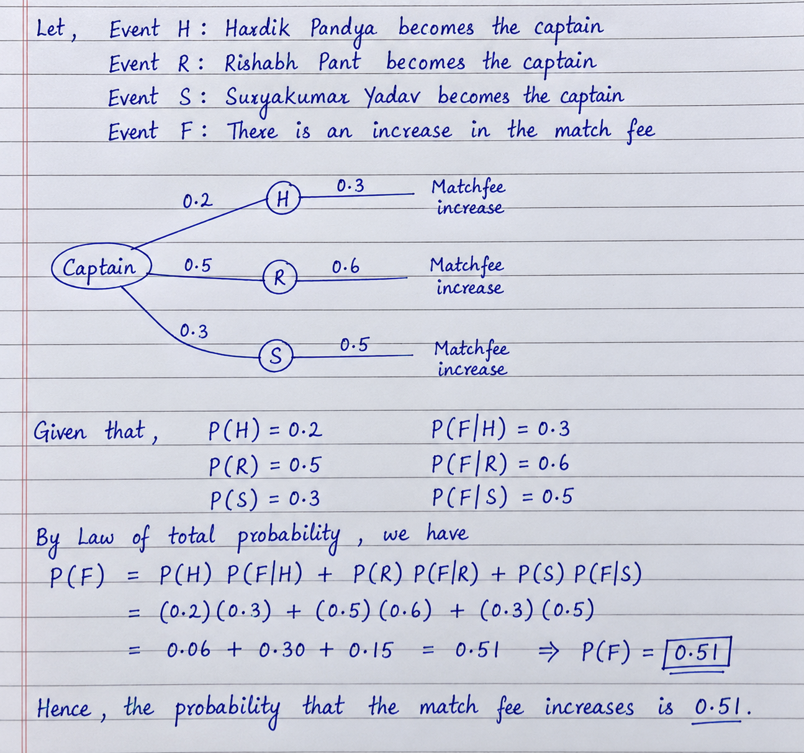
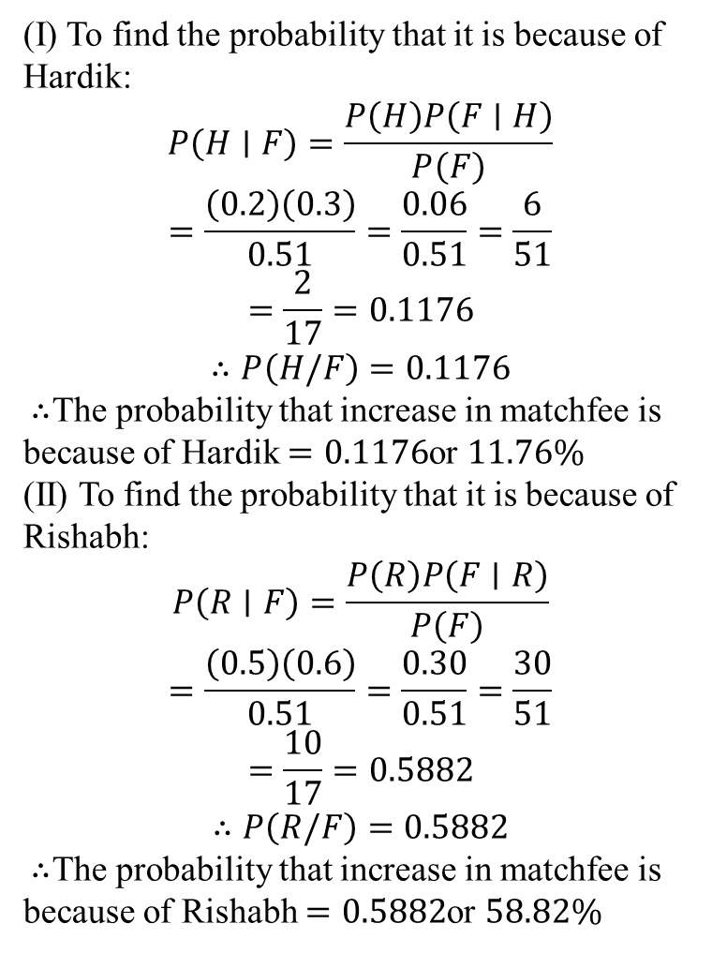
Problem 3 - Solution
(I) To find the probability that it is because of
Hardik:
$$P\left(H∣F\right)=\frac{P\left(H\right)P\left(F∣H\right)}{P\left(F\right)}$$
$$=\frac{\left(0.2\right)\left(0.3\right)}{0.51}=\frac{0.06}{0.51}=\frac{6}{51}$$
$$=\frac{2}{17}=0.1176$$
$$∴P\left(H/F\right)=0.1176$$
∴ The probability that increase in matchfee is because of Hardik $=0.1176$or $11.76\%$
(II) To find the probability that it is because of
Rishabh:
$$P\left(R∣F\right)=\frac{P\left(R\right)P\left(F∣R\right)}{P\left(F\right)}$$
$$=\frac{\left(0.5\right)\left(0.6\right)}{0.51}=\frac{0.30}{0.51}=\frac{30}{51}$$
$$=\frac{10}{17}=0.5882$$
$$∴P\left(R/F\right)=0.5882$$
∴ The probability that increase in matchfee is
because of Rishabh $=0.5882$or $58.82\%$

Slide 14
Problem 4
EC2R
JAN 2024
In a manufacturing company Machine 1 produces 40% of the items
and Machine 2 and Machine 3 produces 25% and 35% of the items respectively.
But from the past records it is found that 15%, 20% and 25% of the items they produce are defective.
Then find
i) Total percentage of defective items produced
ii) If a defective item is selected randomly, then find the probability that it is
produced by Machine 1
iii) If a defective item is selected randomly, then find the probability that it is
not produced by Machine 2

Slide 15
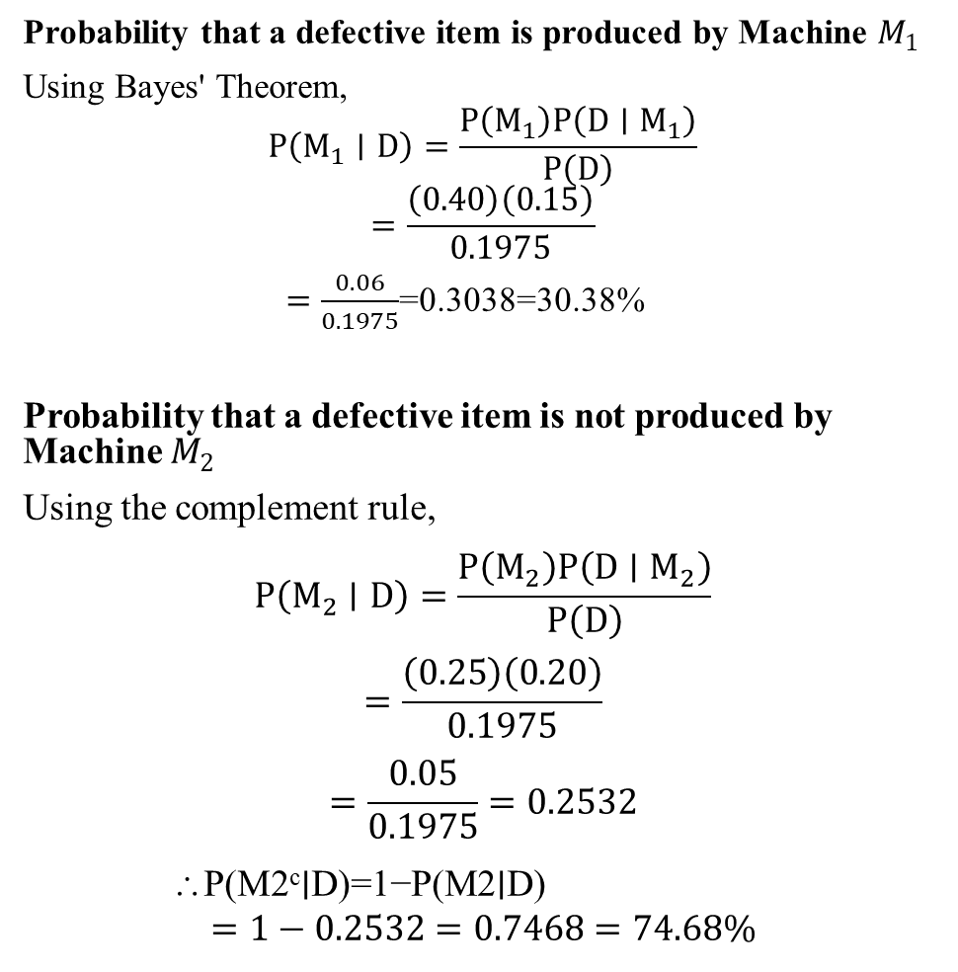
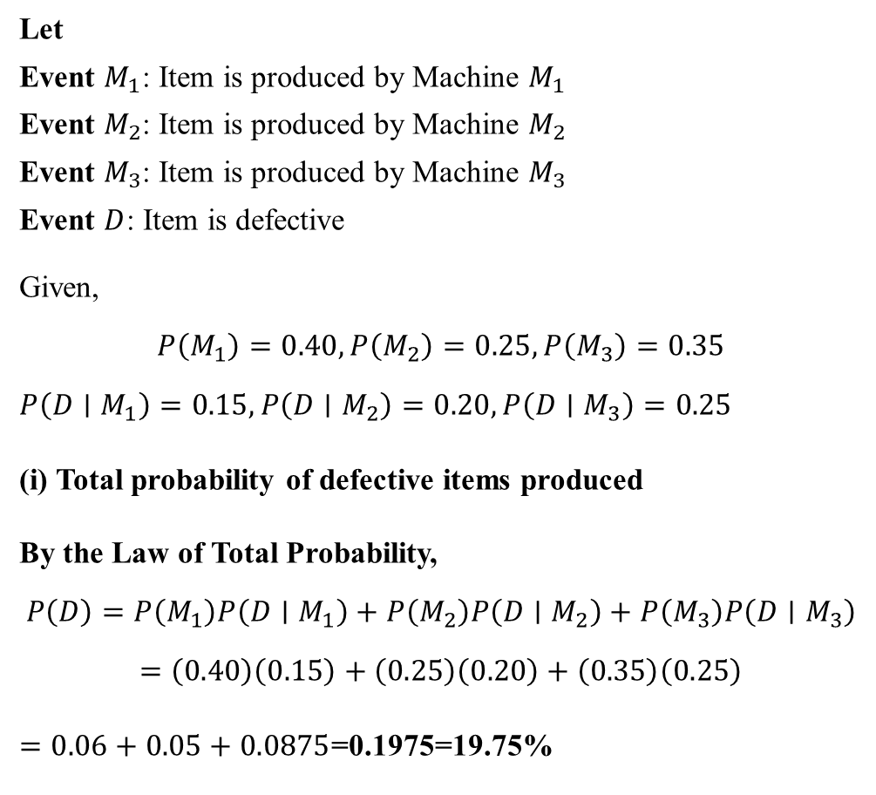
Solution
Probability that a defective item is produced by Machine $M_{1}$
Using Bayes' Theorem,
$$P\left(M_{1}∣D\right)=\frac{P\left(M_{1}\right)P\left(D∣M_{1}\right)}{P\left(D\right)}$$
$$=\frac{\left(0.40\right)\left(0.15\right)}{0.1975}$$
$=\frac{0.06}{0.1975}$=0.3038=30.38%
Probability that a defective item is not produced by Machine $M_{2}$
Using the complement rule,
$$P\left(M_{2}∣D\right)=\frac{P\left(M_{2}\right)P\left(D∣M_{2}\right)}{P\left(D\right)}$$
$$=\frac{\left(0.25\right)\left(0.20\right)}{0.1975}$$
$$=\frac{0.05}{0.1975}=0.2532$$
∴P(M2^{c}∣D)=1−P(M2​∣D)
$$=1−0.2532=0.7468=74.68\%$$
Let
Event $M_{1}$: Item is produced by Machine $M_{1}$
Event $M_{2}$: Item is produced by Machine $M_{2}$
Event $M_{3}$: Item is produced by Machine $M_{3}$
Event $D$: Item is defective
Given,
$$P\left(M_{1}\right)=0.40, P\left(M_{2}\right)=0.25, P\left(M_{3}\right)=0.35$$
$$P\left(D∣M_{1}\right)=0.15,P\left(D∣M_{2}\right)=0.20, P\left(D∣M_{3}\right)=0.25$$
(i) Total probability of defective items produced
By the Law of Total Probability,
$$P\left(D\right)=P\left(M_{1}\right)P\left(D∣M_{1}\right)+P\left(M_{2}\right)P\left(D∣M_{2}\right)+P\left(M_{3}\right)P\left(D∣M_{3}\right)$$
$$=\left(0.40\right)\left(0.15\right)+\left(0.25\right)\left(0.20\right)+\left(0.35\right)\left(0.25\right)$$
$=0.06+0.05+0.0875$=0.1975=19.75%

Slide 16
Problem 5
EC2M
JAN 2024
A product is manufactured by four companies A, B,C and D. They produce 20%, 30%, 40% and 10% of the products released in the market. But it is observed that 30%, 20%, 10% and 25% are defective items manufactured by them respectively. Then find
Total percentage of defective items manufactured
The percentage that the selected defective item is produced by company A
The percentage that the selected defective item is not produced by company B
The percentage that the selected defective item is not produced by company D

Slide 17
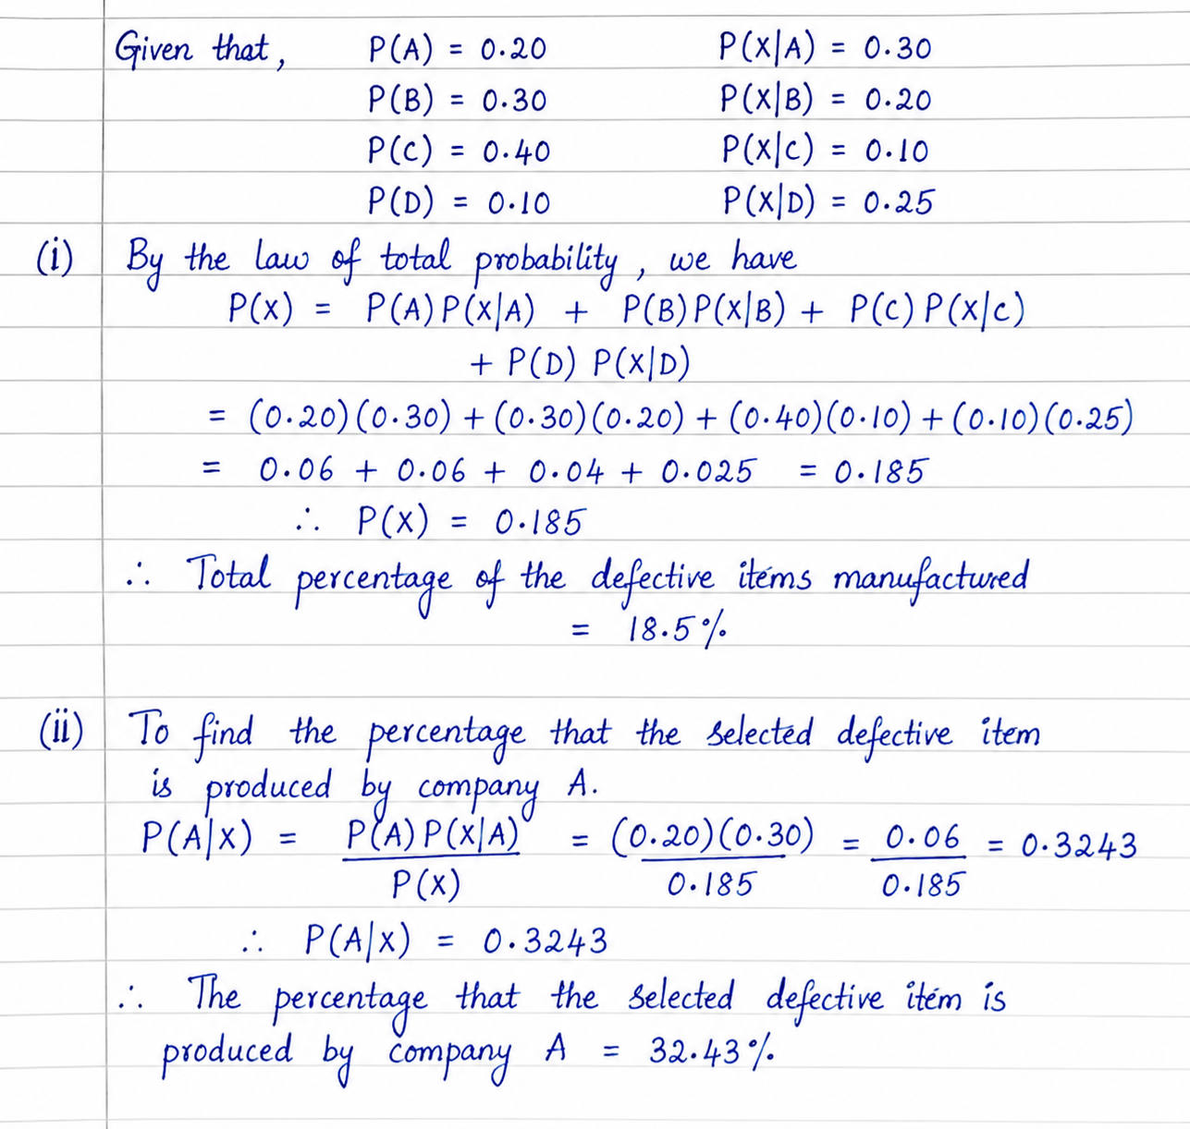
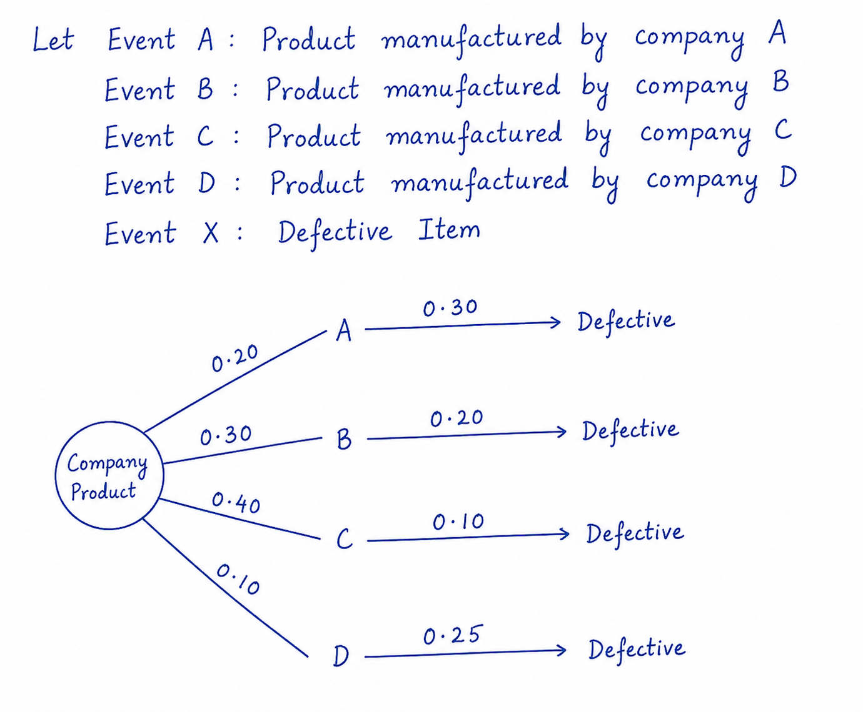
Problem 5 - Solution

Slide 18
Problem 5 - Solution
(iii) To find the percentage that the selected defective item is
not produced by company B
P(Bᶜ|X) = 1 − P(B|X) = 1 − ( P(B) P(X|B) / P(X) )
= 1 − ( (0.30)(0.20) / 0.185 )
= 1 − ( 0.06 / 0.185 )
= 1 − 0.3243
= 0.6757
∴ P(Bᶜ|X) = 0.6757
∴ The percentage that the selected defective item
is not produced by B = 67.57%.
(iv) To find the percentage that the selected defective item
is not produced by company D.
P(Dᶜ|X) = 1 − P(D|X) = 1 − ( P(D) P(X|D) / P(X) )
= 1 − ( (0.10)(0.25) / 0.185 )
= 1 − ( 0.025 / 0.185 )
= 1 − 0.1351
= 0.8649
∴ P(Dᶜ|X) = 0.8649
∴ The percentage that the selected defective item
is not produced by company D = 86.49%.

Slide 19
Naïve Bayes Classifier
Naïve Bayes classifiers are a collection of algorithms based on Bayes’ Theorem. It is not a single algorithm but a family of algorithms where all of them share a common principle, i.e., every pair of features being classified as independent of each other.
Naïve Bayes classifier is one of the most simple and effective classification algorithms, that aids in the rapid development of machine learning models with rapid prediction capabilities.
It is highly used in text classification tasks where data contains high dimension (as each word represent one feature in the data). It is fast and making prediction easy with high dimension data.
It is a probabilistic classifier, that predicts the probability of an instance belongs to a class with a given set of feature value. It uses Bayes theorem in the algorithm for training and prediction.

Slide 20
Why is it called Naïve Bayes?
The “Naïve” part of the name indicates the simplifying assumption made by the Naïve Bayes Classifier. The classifier assumes that the features used to describe an observation are conditionally independent, given the class label.

Slide 21
Assumptions of Naïve Bayes
The fundamental Naive Bayes assumption is that each feature makes an:
Feature independence: The features of the data are conditionally independent of each other, given the class label.
Continuous features are normally distributed: If a feature is continuous, then it is assumed to be normally distributed within each class.
Discrete features have multinomial distributions: If a feature is discrete, then it is assumed to have a multinomial distribution within each class.
Features are equally important: All features are assumed to contribute equally to the prediction of the class label.
No missing data: The data should not contain any missing values.

Slide 22
Types of Naïve Bayes Model
Gaussian Naïve Bayes Classifier : The Gaussian Naive Bayes classifier assumes that the attributes of a dataset have a normal distribution. Here, if the attributes have continuous values, the classification model assumes that the values are sampled from a Gaussian distribution.
Multinomial Naïve Bayes: When the input data is multinomially distributed, we use the multinomial naive Bayes classifier. This algorithm is primarily used for document classification problems like sentiment analysis.
Bernoulli Naïve Bayes: The Bernoulli Naive Bayes classification works in a similar manner to the multinomial classification. The difference is that the attributes of the dataset contain boolean values representing the presence or absence of a particular attribute in a data point.

Slide 23
Advantages of Naïve Bayes Classifier
Easy to implement and computationally efficient.
Effective in cases with a large number of features.
Performs well even with limited training data.
It performs well in the presence of categorical features.
For numerical features data is assumed to come from normal distributions

Slide 24
Disadvantages of Naive Bayes Classifier
Assumes that features are independent, which may not always hold in real-world data.
Can be influenced by irrelevant attributes.
May assign zero probability to unseen events, leading to poor generalization.

Slide 25
Implementation of Naïve Bayes classifier
To implement a Naive Bayes classifier, we perform three steps.
First, we calculate the probability of each class label in the training dataset.
Next, we calculate the conditional probability of each attribute of the training data for each class label given in the training data.
Finally, we use the Bayes theorem and the calculated probabilities to predict class labels for new data points. For this, we will calculate the probability of the new data point belonging to each class. The class with which we get the maximum probability is assigned to the new data point.

Slide 26
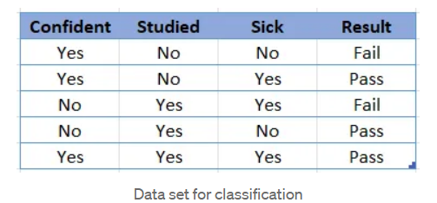
Problem 6
Consider the following data set:
Find out whether the object with attribute Confident = Yes, Sick = No will Fail or Pass using Bayesian Classification.

Slide 27
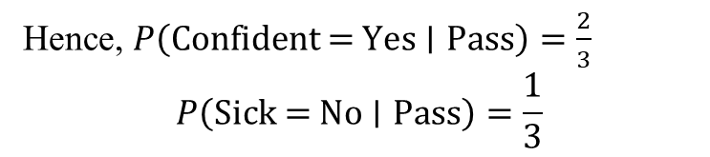


Solution:
Calculate Conditional Probabilities For Class = Pass
Among the three Pass records:
Given Data Set
Confident | Sick
Yes | Yes
No | No
Yes | Yes
Confident | Studied | Sick | Result
Yes | No | No | Fail
Yes | No | Yes | Pass
No | Yes | Yes | Fail
No | Yes | No | Pass
Yes | Yes | Yes | Pass
Hence, $P\left(\text{Confident}\text{ = }\text{Yes}∣\text{Pass}\right)=\frac{2}{3}$
$$P\left(\text{Sick}\text{ = }\text{No}∣\text{Pass}\right)=\frac{1}{3}$$
We have to find whether the new student with attributes: Confident = Yes ;Sick = No will pass or fail.
For Class = Fail
Among the two Fail records:
Calculate Prior Probabilities:
Total number of records = 5
Number of Pass records = 3
Number of Fail records = 2
$∴P\left(\text{Pass}\right)=\frac{3}{5}$ & $P\left(\text{Fail}\right)=\frac{2}{5}$
Confident | Sick
Yes | No
No | Yes
$$P\left(\text{Confident}\text{ = }\text{Yes}∣\text{Fail}\right)=\frac{1}{2}$$
$$P\left(\text{Sick}\text{ = }\text{No}∣\text{Fail}\right)=\frac{1}{2}$$

Slide 28
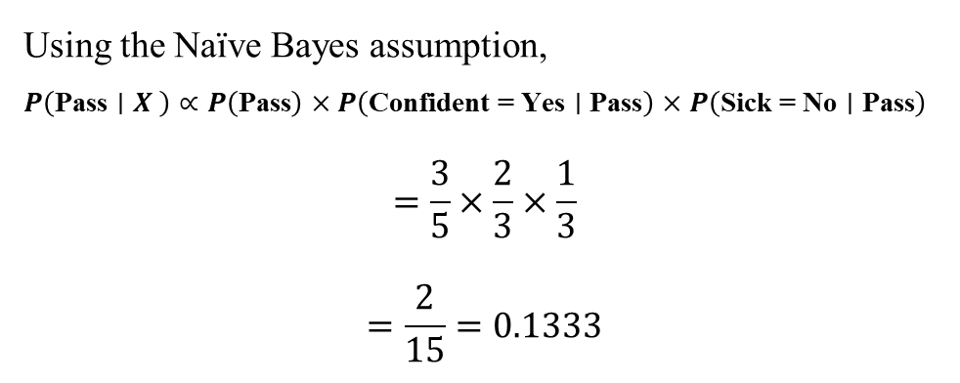
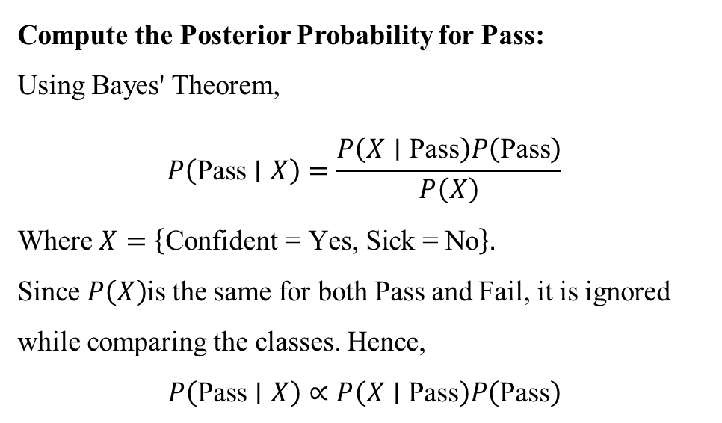
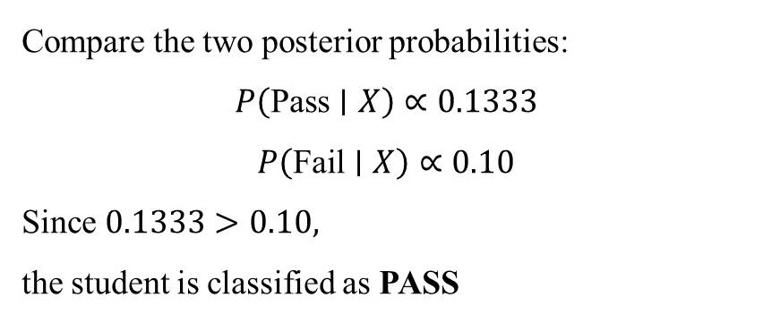
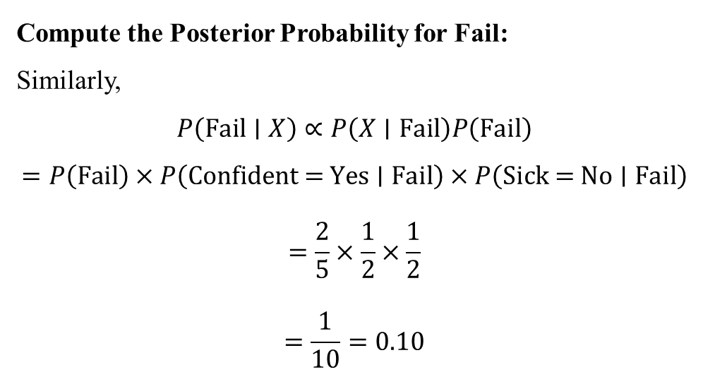
Compute the Posterior Probability for Pass:
Using Bayes' Theorem,
$$P\left(\text{Pass}∣X\right)=\frac{P\left(X∣\text{Pass}\right)P\left(\text{Pass}\right)}{P\left(X\right)}$$
Where $X=\left\{\text{Confident}\text{ = }\text{Yes}\text{, }\text{Sick}\text{ = }\text{No}\right\}.$
Since $P\left(X\right)$is the same for both Pass and Fail, it is ignored while comparing the classes. Hence,
$$P\left(\text{Pass}∣X\right)∝P\left(X∣\text{Pass}\right)P\left(\text{Pass}\right)$$
Compute the Posterior Probability for Fail:
Similarly,
$$P\left(\text{Fail}∣X\right)∝P\left(X∣\text{Fail}\right)P\left(\text{Fail}\right)$$
$$=P\left(\text{Fail}\right)×P\left(\text{Confident}\text{ = }\text{Yes}∣\text{Fail}\right)×P\left(\text{Sick}\text{ = }\text{No}∣\text{Fail}\right)$$
$$=\frac{2}{5}×\frac{1}{2}×\frac{1}{2}$$
$$=\frac{1}{10}=0.10$$
Compare the two posterior probabilities:
$$P\left(\text{Pass}∣X\right)∝0.1333$$
$$P\left(\text{Fail}∣X\right)∝0.10$$
Since $0.1333>0.10,$
the student is classified as PASS
Using the Naïve Bayes assumption,
$$P\left(\text{Pass}∣X \right)∝P\left(\text{Pass}\right)×P\left(\text{Confident}\text{ = }\text{Yes}∣\text{Pass}\right)×P\left(\text{Sick}\text{ = }\text{No}∣\text{Pass}\right)$$
$$=\frac{3}{5}×\frac{2}{3}×\frac{1}{3}$$
$$=\frac{2}{15}=0.1333$$

Slide 29
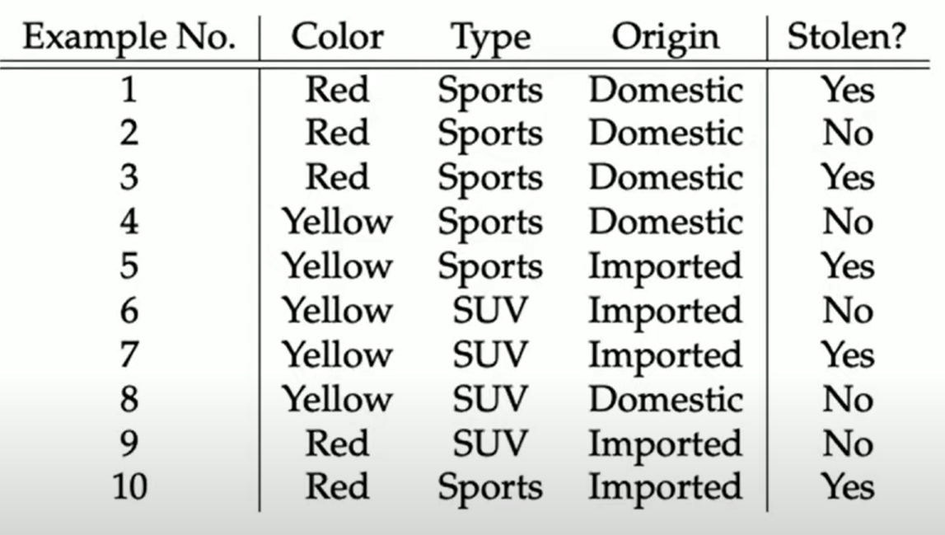
Problem 7

Slide 30
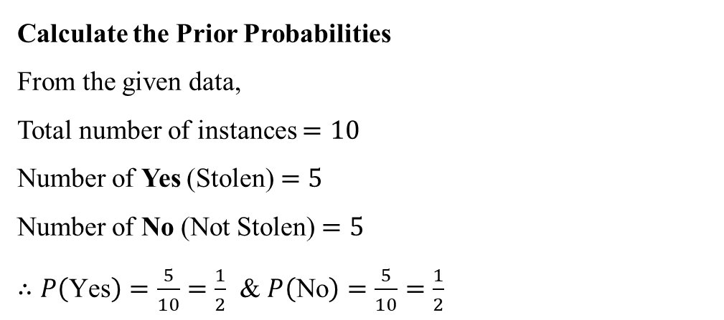
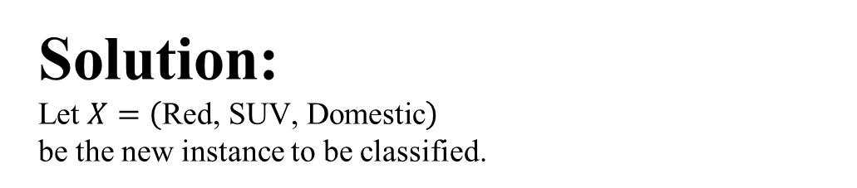
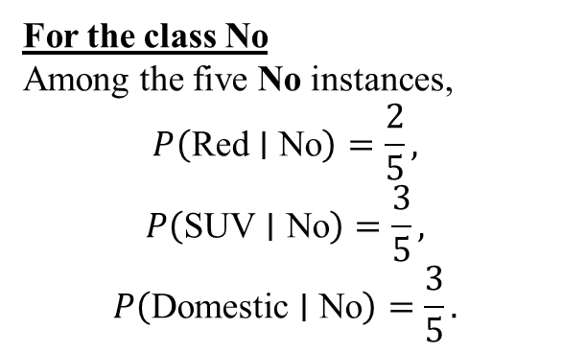
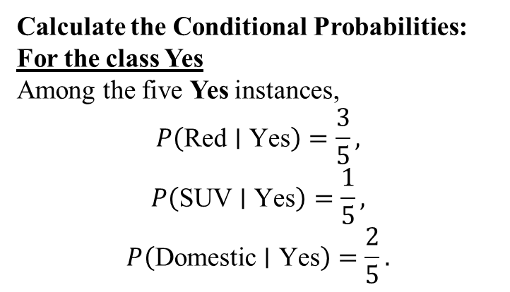
Solution:
Let $X=\left(\text{Red}\text{, }\text{SUV}\text{, }\text{Domestic}\right)$
be the new instance to be classified.
For Class = Yes (Stolen) There are 5 instances with Yes.
Attribute | Value | Count
Color | Red | 3
Color | Yellow | 2
Type | Sports | 4
Type | SUV | 1
Origin | Domestic | 2
Origin | Imported | 3
For Class = No (Not Stolen) There are 5 instances with No.
Attribute | Value | Count
Color | Red | 2
Color | Yellow | 3
Type | Sports | 2
Type | SUV | 3
Origin | Domestic | 3
Origin | Imported | 2
Calculate the Prior Probabilities
From the given data,
Total number of instances $=10$
Number of Yes (Stolen) $=5$
Number of No (Not Stolen) $=5$
$∴P\left(\text{Yes}\right)=\frac{5}{10}=\frac{1}{2}$ & $P\left(\text{No}\right)=\frac{5}{10}=\frac{1}{2}$
Calculate the Conditional Probabilities:
For the class Yes
Among the five Yes instances,
$$P\left(\text{Red}∣\text{Yes}\right)=\frac{3}{5},$$
$$P\left(\text{SUV}∣\text{Yes}\right)=\frac{1}{5},$$
$$P\left(\text{Domestic}∣\text{Yes}\right)=\frac{2}{5}.$$
For the class No
Among the five No instances,
$$P\left(\text{Red}∣\text{No}\right)=\frac{2}{5},$$
$$P\left(\text{SUV}∣\text{No}\right)=\frac{3}{5},$$
$$P\left(\text{Domestic}∣\text{No}\right)=\frac{3}{5}.$$

Slide 31
Solution contd.,
Compute the Posterior Probability for Yes and No:
∴ P(Yes | X) = P(Yes | Red , SUV , Domestic)
= P(Yes) × P(Red | Yes)
× P(SUV | Yes)
× P(Domestic | Yes)
= 1/2 × 3/5 × 1/5 × 2/5
= 3/125
= 0.024
∴ P(Yes | Red , SUV , Domestic) = 0.024
P(No | X) = P(No | Red , SUV , Domestic)
= P(No) × P(Red | No)
× P(SUV | No)
× P(Domestic | No)
= 1/2 × 2/5 × 3/5 × 3/5
= 9/125
= 0.072
∴ P(No | Red , SUV , Domestic) = 0.072
Conclusion:
Since P(No | X) > P(Yes | X)
∴ The new instance belongs to “No” class.

Slide 32
Random Variables
Motivation:
In most statistical problems we are concerned with one number or a few numbers that are associated with the outcomes of experiments.
When inspecting a manufactured product we may be interested only in the number of defectives; in the analysis of a road test we may be interested only in the average speed and the average fuel consumption; and in the study of the performance of a miniature rechargeable battery we may be interested only in its power and life length. All these numbers are associated with situations involving an element of chance—in other words, they are values of random variables.

Slide 33
Random Variables
A random variable is a real valued function defined on the sample space
The random variable is the observation.
The random variable is a function of the observation.
A random variable consists of an experiment with a probability measure P[·] defined on a sample space S and a function that assigns a real number to each outcome in the sample space of the experiment.
Advantages:
When the elements of the sample space are non-numeric, they can be quantified by assigning a real number to every event of the sample space. A real number X associated with the outcome of a random experiment.
Infinite sample space can be converted to finite

Slide 34
Random Variables - Classification
Random variables are usually classified according to the number of values they can assume. Random variable can be classified as
discrete random variables, which can take on only a finite number
an uncountable infinity of values; called continuous random variables
Examples:
Number of accidents on a highway – Discrete
Weights of the students of the class – Continuous

Slide 35
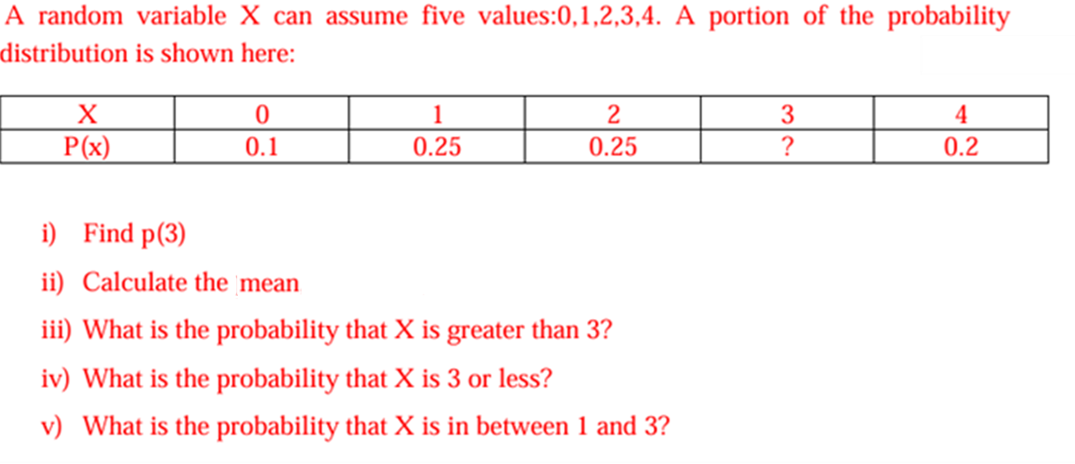
Discrete Random Variables – Problem 8
EC2M July 2022

Slide 36
Problem 8 - Solution
(iii) P(X > 3) = P(X = 4) = 0.2
∴ P(X > 3) = 0.2
(iv) P(X ≤ 3) = P(X = 0) + P(X = 1)
+ P(X = 2) + P(X = 3)
= 0.1 + 0.25 + 0.25 + 0.2
= 0.8
∴ P(X ≤ 3) = 0.8
(v) P(1 < X < 3) = P(X = 2) = 0.25
∴ P(1 < X < 3) = 0.25
Given probability distribution is
(X) | 0 | 1 | 2 | 3 | 4
(P(X=x)) | 0.10 | 0.25 | 0.25 | ? | 0.20
(i) We know that,
∑ P(x) = 1
⇒ 0.1 + 0.25 + 0.25 + P(3) + 0.2 = 1
⇒ 0.8 + P(3) = 1
⇒ P(3) = 1 − 0.8
⇒ P(3) = 0.2
(ii) Mean = E(X) = ∑ x P(x)
= 0(0.1) + 1(0.25) + 2(0.25) + 3(0.2) + 4(0.2)
= 0 + 0.25 + 0.5 + 0.6 + 0.8
= 2.15
∴ Mean = 2.15

Slide 37
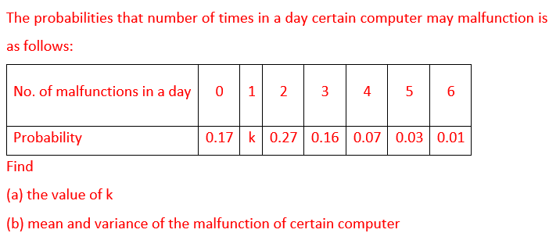
Discrete Random Variables – Problem 9
APR EC2 22

Slide 38
Solution
Given probability distribution is
(a) We know that
∑ P(x) = 1
⇒ 0.17 + K + 0.27 + 0.16 + 0.07 + 0.03 + 0.01 = 1
⇒ 0.71 + K = 1
⇒ K = 1 − 0.71
⇒ K = 0.29
(b) Mean = E(X) = ∑ xP(x)
= 0(0.17) + 1(0.29) + 2(0.27) + 3(0.16)
+ 4(0.07) + 5(0.03) + 6(0.01)
= 0 + 0.29 + 0.54 + 0.48 + 0.28 + 0.15 + 0.06
= 1.8
∴ Mean = 1.8
Var(X) = E(X²) − (E(X))²
E(X²) = ∑ x² P(x)
= (0)²(0.17) + (1)²(0.29) + (2)²(0.27)
+ (3)²(0.16) + (4)²(0.07)
+ (5)²(0.03) + (6)²(0.01)
= 0 + 0.29 + 4(0.27) + 9(0.16)
+ 16(0.07) + 25(0.03) + 36(0.01)
= 0.29 + 1.08 + 1.44 + 1.12 + 0.75 + 0.36
= 5.04
∴ E(X²) = 5.04
Var(X) = E(X²) − (E(X))²
= 5.04 − (1.8)²
= 5.04 − 3.24
= 1.8
∴ Var(X) = 1.8
Number of Malfunctions, (X) | 0 | 1 | 2 | 3 | 4 | 5 | 6
P(X=x) | 0.17 | (k) | 0.27 | 0.16 | 0.07 | 0.03 | 0.01

Slide 39
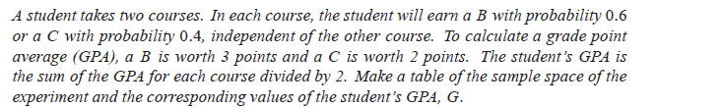
Random Variable – Probability Distribution:
Problem 10

Slide 40
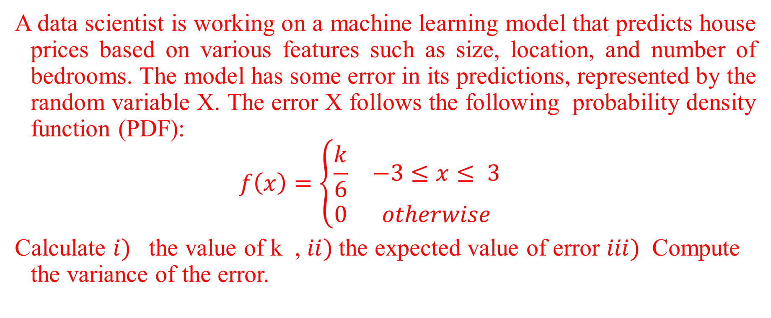
Continuous Random Variables: Problem 11
EC2 M S1-24
A data scientist is working on a machine learning model that predicts house prices based on various features such as size, location, and number of bedrooms. The model has some error in its predictions, represented by the random variable X. The error X follows the following probability density function (PDF):
$$f\left(x\right)=\left\{\begin{matrix}\frac{k}{6} & −3≤x≤ 3 \\ 0 & otherwise\end{matrix}\right.$$
Calculate $i)$ the value of k , $ii)$the expected value of error $iii)$ Compute the variance of the error.

Slide 41
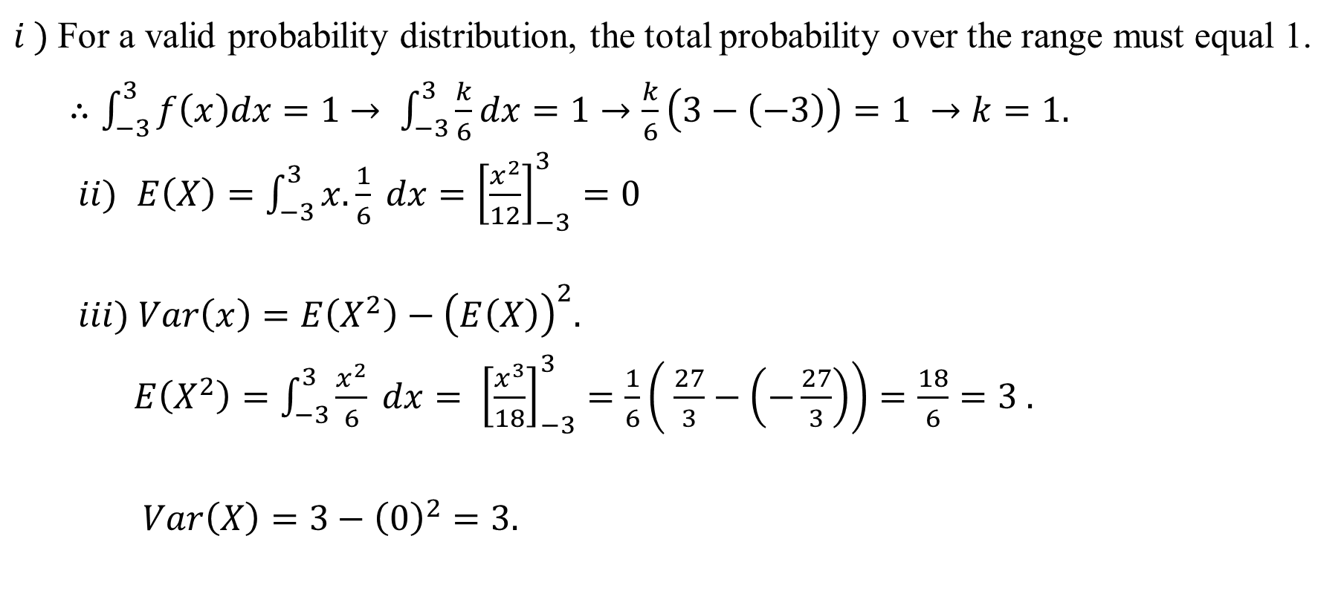
Problem 11 - Solution
$i )$For a valid probability distribution, the total probability over the range must equal 1.
$∴\int_{−3}^{3}{f\left(x\right)dx=1}$ $→ \int_{−3}^{3}{\frac{k}{6}dx=1→\frac{k}{6}\left(3−\left(−3\right)\right)=1 →k=1.}$
$ii)$ $E\left(X\right)=\int_{−3}^{3}{x. \frac{1}{6} dx={\left[\frac{x^{2}}{12}\right]}_{−3}^{3}=0}$
$iii) Var\left(x\right)=E\left(X^{2}\right)−{\left(E\left(X\right)\right)}^{2}.$
$E\left(X^{2}\right)={\int_{−3}^{3}{\frac{x^{2}}{6} dx= \left[\frac{x^{3}}{18}\right]}}_{−3}^{3}=\frac{1}{6}\left( \frac{27}{3}−\left(−\frac{27}{3}\right)\right)=\frac{18}{6}=3 .$
$Var\left(X\right)=3−{\left(0\right)}^{2}=3.$

Slide 42

Continuous Random Variables – Problem 12
EC2R
JULY 2024
Let f(x) be a continuous random variable defined in [0,2] as
f(x) = k(x + 1)/4, then find
(a) k value
(b) mean of x
(c) Expectation of $x^{2}$
(d) Variance
(e) P(0.5 < x < 1.5)

Slide 43
Problem 12 - Solution

Slide 44
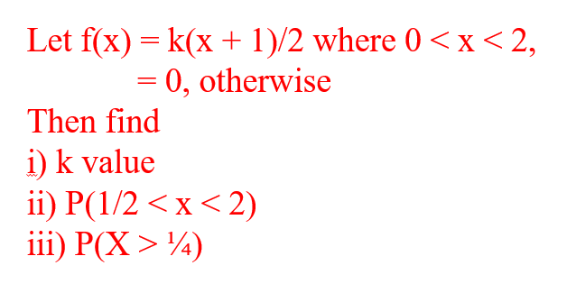
Continuous Random Variables – Problem 13
EC2R
JAN 2024

Slide 45
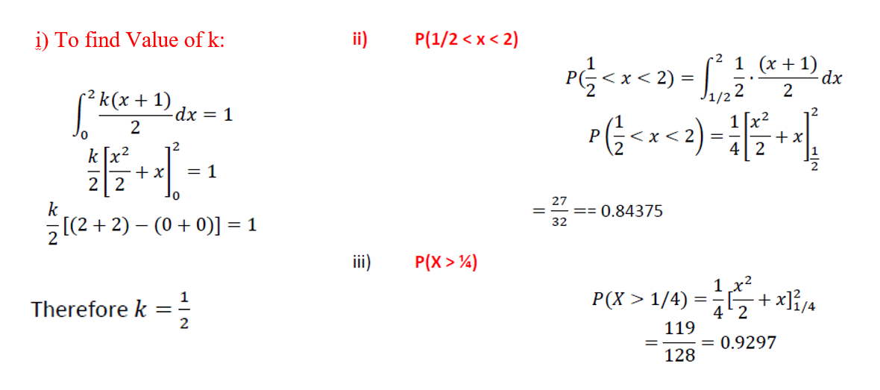
Problem 13 - Solution

Slide 46
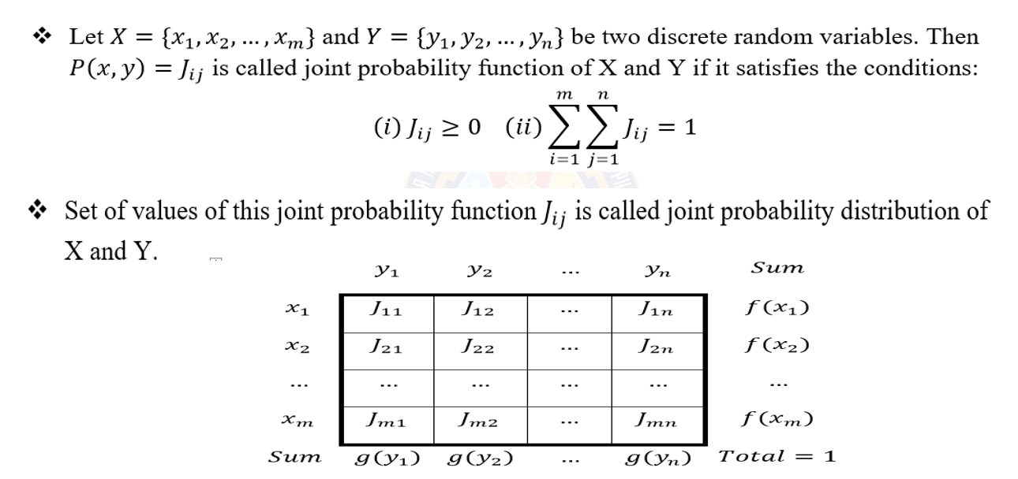
Joint Probability Distribution Function

Slide 47
Joint Probability Distribution Function
If X and Y are discrete random variables, the joint probability distribution of X and Y is a description of the set of points (x,y) in the range of (X,Y) along with the probability of each point.
The joint probability distribution of two discrete random variables is sometimes referred to as the bivariate probability distribution or bivariate distribution.
Thus, we can describe the joint probability distribution of two discrete random variables is through a joint probability mass function
f(x,y) = P(X=x, Y=y)

Slide 48

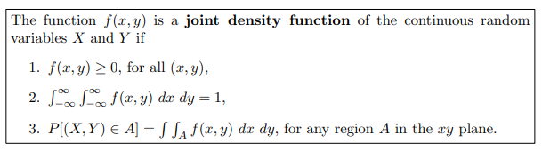
Joint Density Function

Slide 49
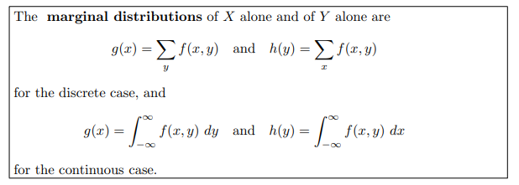
Marginal Distributions

Slide 50
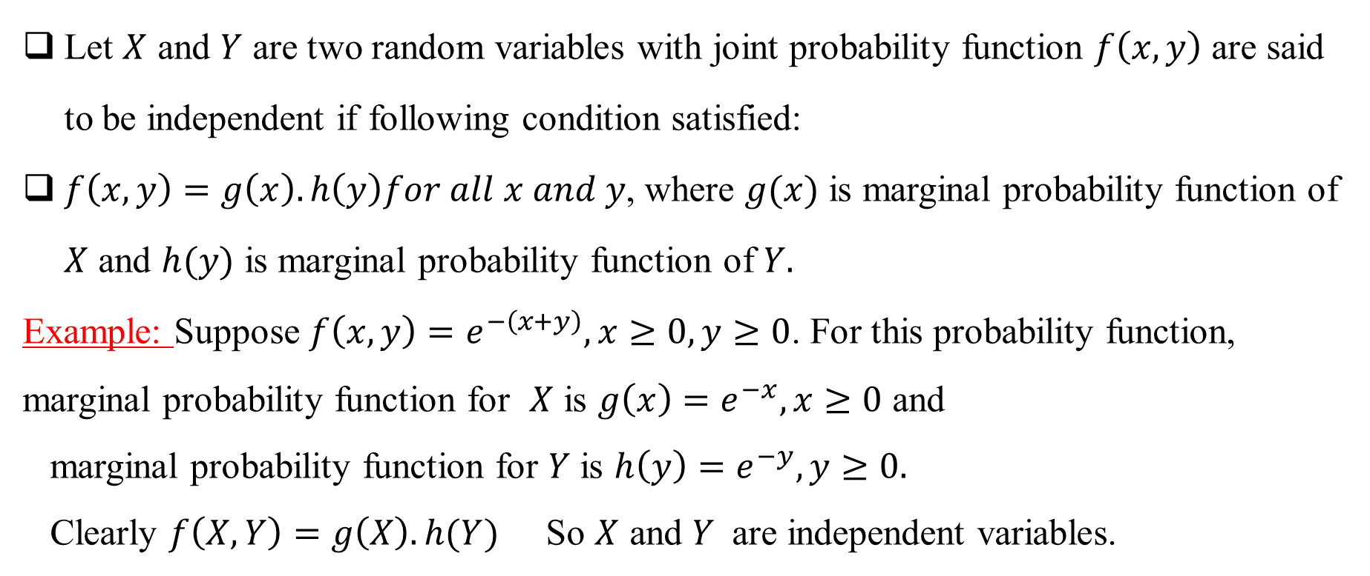
Independent Random Variables
Let $X$ and $Y$ are two random variables with joint probability function $f\left(x,y\right)$ are said to be independent if following condition satisfied:
$f\left(x,y\right)=g\left(x\right).h\left(y\right)for all x and y$, where $g(x)$ is marginal probability function of $X$ and $h(y)$ is marginal probability function of $Y.$
Example: Suppose $f\left(x,y\right)=e^{−\left(x+y\right)}, x≥0, y≥0$. For this probability function, marginal probability function for $X$ is $g\left(x\right)=e^{−x}, x≥0$ and
marginal probability function for $Y$ is ${h\left(y\right)=e}^{−y}, y≥0.$
Clearly $f\left(X,Y\right)=g\left(X\right).h(Y)$ So $X$ and $Y$ are independent variables.

Slide 51
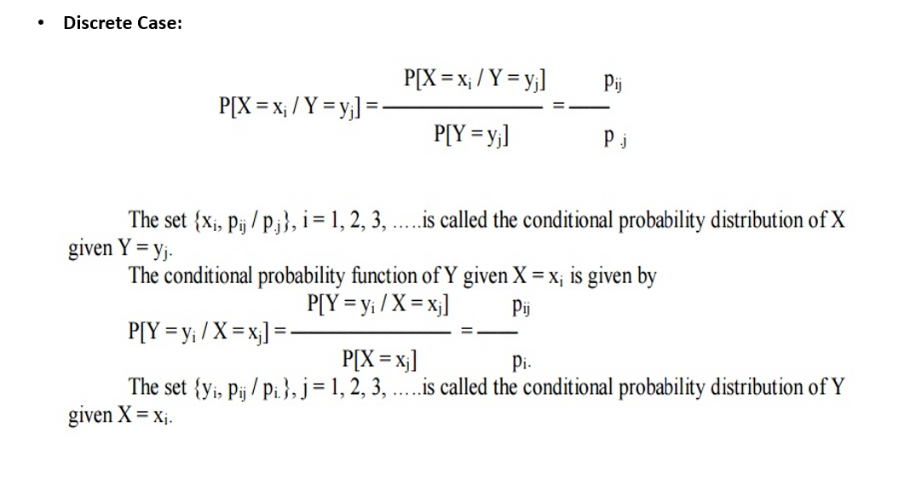
Conditional Probability Distribution Function

Slide 52
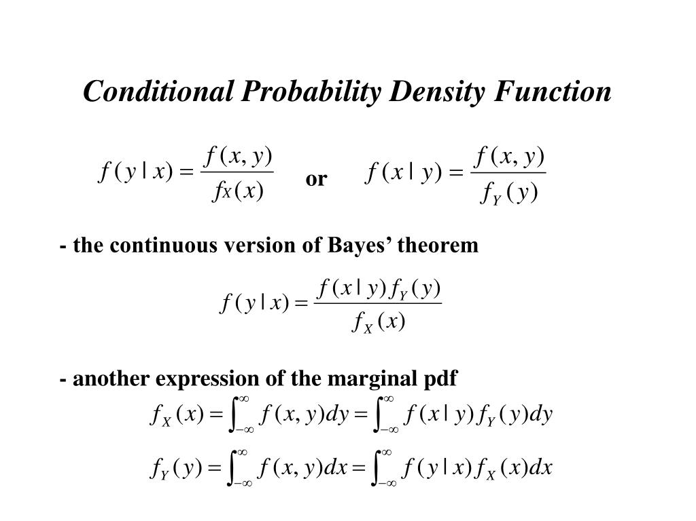
Continuous Case

Slide 53
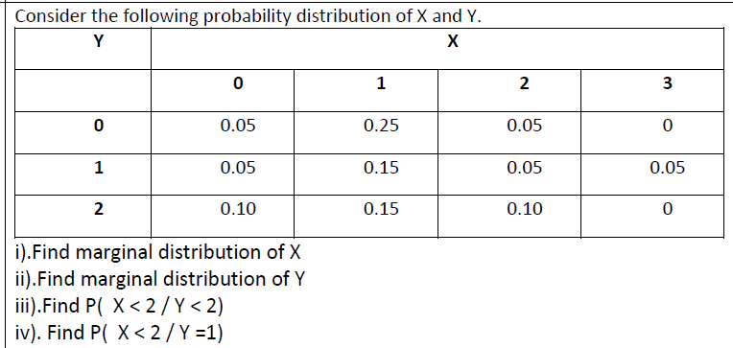
Joint Discrete – Problem 14
EC2R
JAN 2024

Slide 54
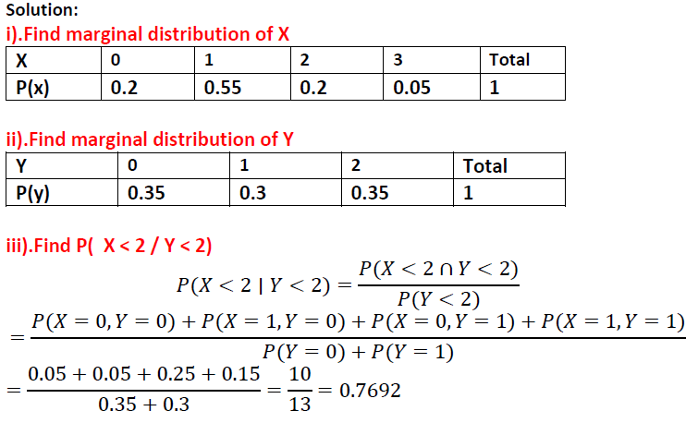
Problem 14 – Solution

Slide 55
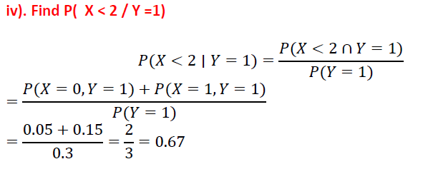
Problem 14 – Solution

Slide 56
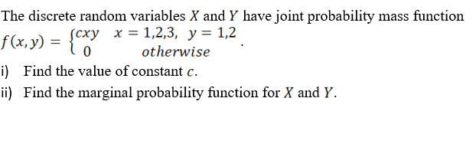
Joint Discrete – Problem 15
EC2R
JAN 2025

Slide 57
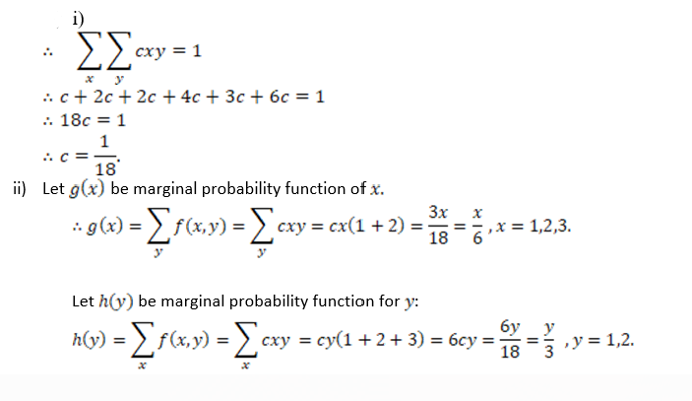
Problem 15 – Solution

Slide 58
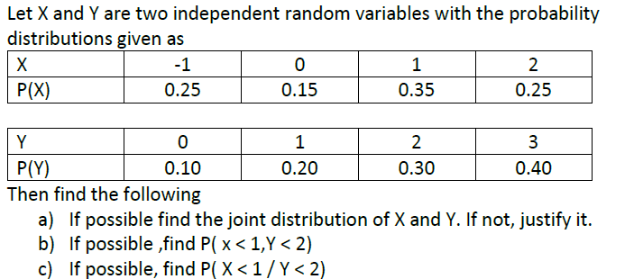
Joint Discrete – Problem 16
EC2R JULY 2024

Slide 59
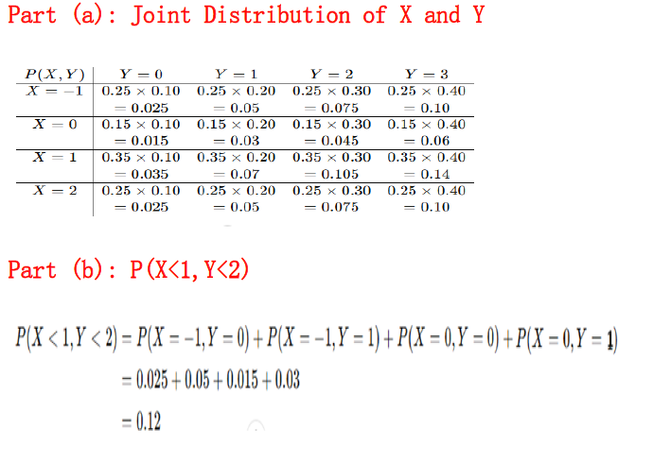
Problem 16 – Solution

Slide 60
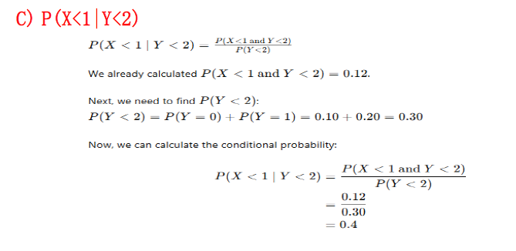
Problem 16 – Solution

Slide 61
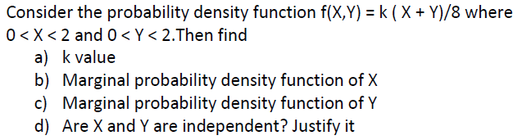
Joint Continuous – Problem 17
EC2 M JULY 2024

Slide 62

Problem 17 – Solution

Slide 63

Joint Continuous – Problem 18
EC2 M FEB 2024

Slide 64


Problem 18 – Solution

Slide 65
Thank You !

